Slide 1
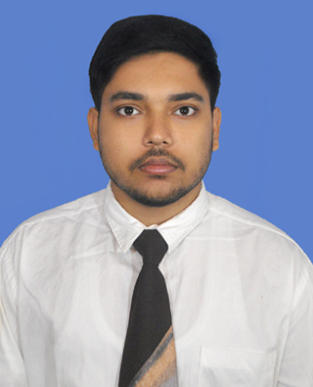

Shubham Raj
Bachelor of Technology,
Electronics and Electrical Engineering : 2018-22
Analyst/Software Engineer
MUMBAI
Skills
shubham.raj@capgemini.com
C# | Basics, OOPS, Exception Handling ,Arrays ,Collection and Generics, Delegates and Events, File Io and Serialization.
.NET Framework | ADO.NET,ASP.NET with MVC5 and WEB API, Entity Framework
JAVA | Basics, OOPS, Exception Handling, Arrays
Database | SQL
Tools | GIT, POSTMAN, Swagger, Azure DevOps
UI Technology | Angular, HTML5 & CSS
Add On Skills | Communication Skills, Team Management
+91 8521209760
A4
Full Stack Developer
Understanding of RDBMS concepts using SQL Server.
Practical understanding of C# and SQL concepts using Visual Studio and SQL Server
Hands on experience in developing applications using .NET Framework, ADO.NET Core
Good understanding concepts of Data structure (Linked List ,BST ,stack ,queue)
Understanding of HTML5, CSS and Angular CLI.
Basic Knowledge of Azure DevOps.
Completed case study on Railway Reservation which is a Web-based System. The traditional way of booking a ticket is very time-consuming and cancellation is also a long process. The existing system has Latency while we search for train details. The existing system also gets crashed many times while booking a ticket. So, we will design a system which will enable the booking in any class, and a maximum of six berths/seats at a time, for a journey between any two stations served by a train.
Technologies used:
ANGULAR
ASP.NET CORE
Microsoft SQL Server
Video Link - Link
- Link
https://github.com/sdsameer07

